Slide 1



What does the Antibody want for Antibody-dependent cellular Christmas (ADCC)?
Luke Heirene
Helen Byrne
Eamonn Gaffney
James Yates
This Photo by Unknown Author is licensed under CC BY-NC

Slide 2
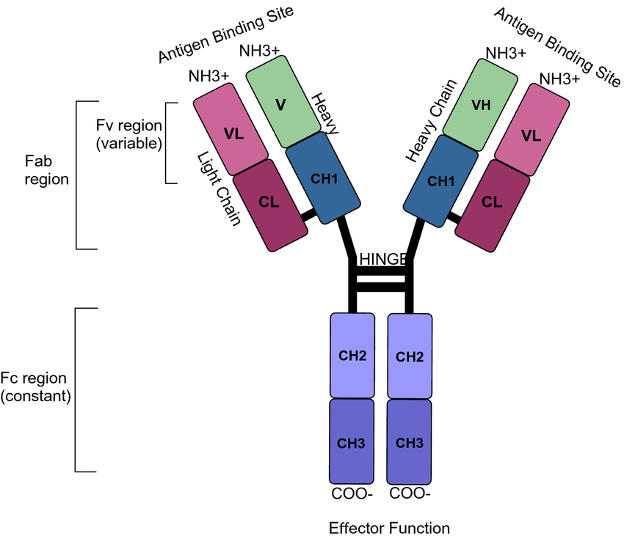
Monoclonal Antibodies

Slide 3
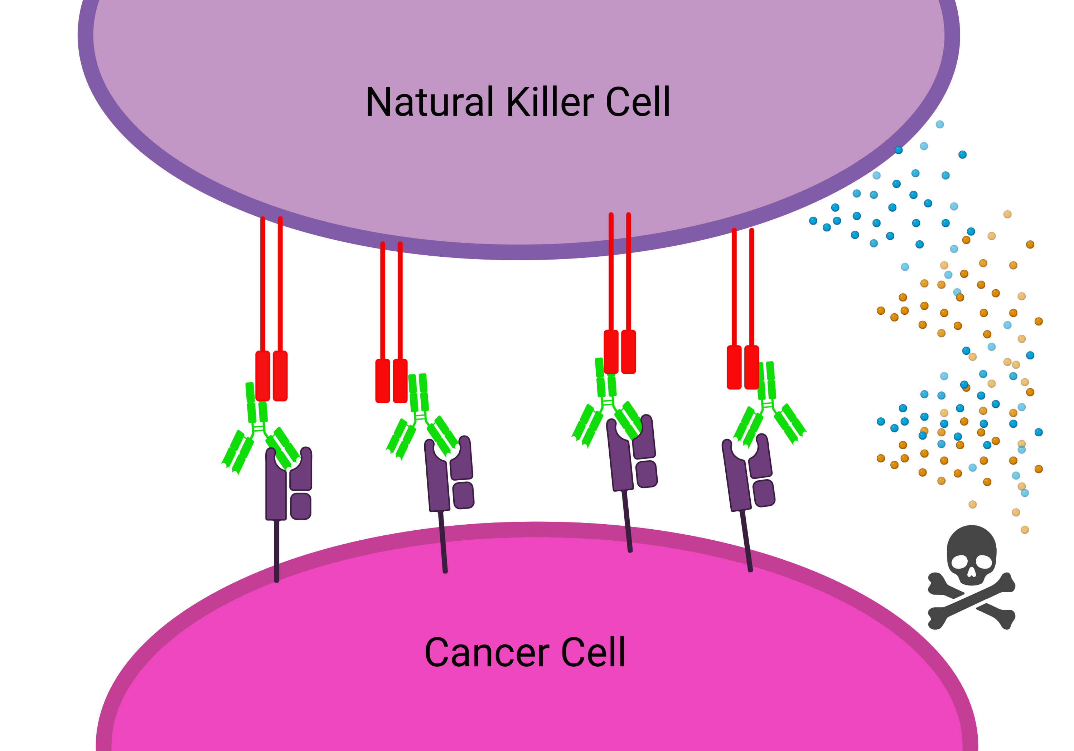
Effector functions
More cell-bound antibodies
Improved ADCC potency

Slide 4
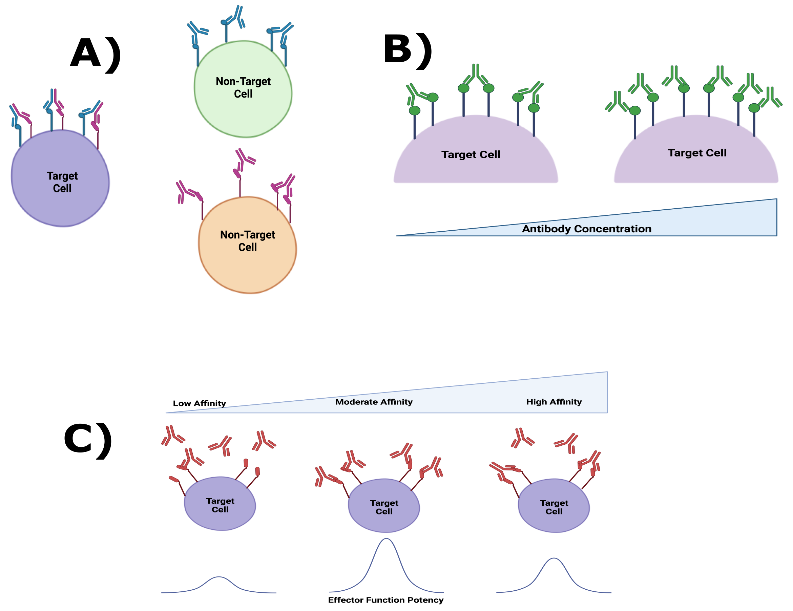
Improving Effector function Potency
PLoS One. 2016 Jun 20;11(6):e0157788. doi: 10.1371/journal.pone.0157788. eCollection 2016.

Slide 5
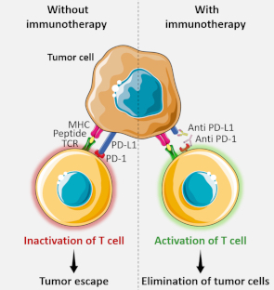
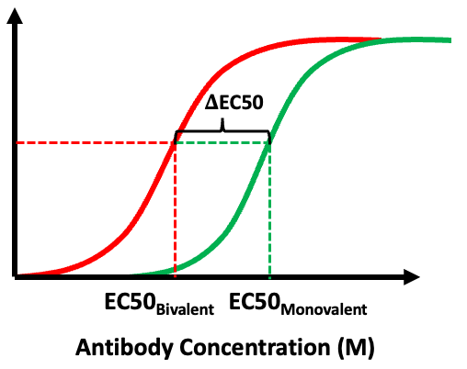
Bound Antibodies
Avidity Effect
Receptor Occupancy

Slide 6
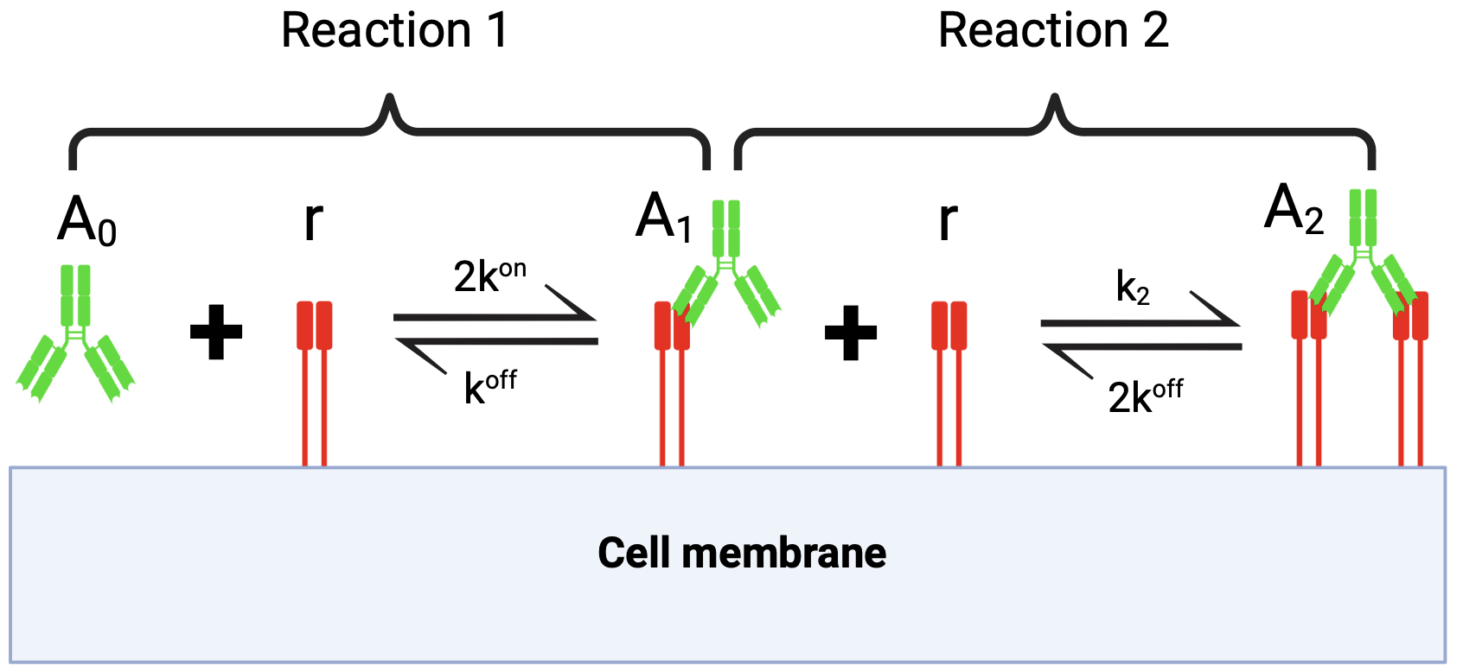
Mathematical Model

Slide 7
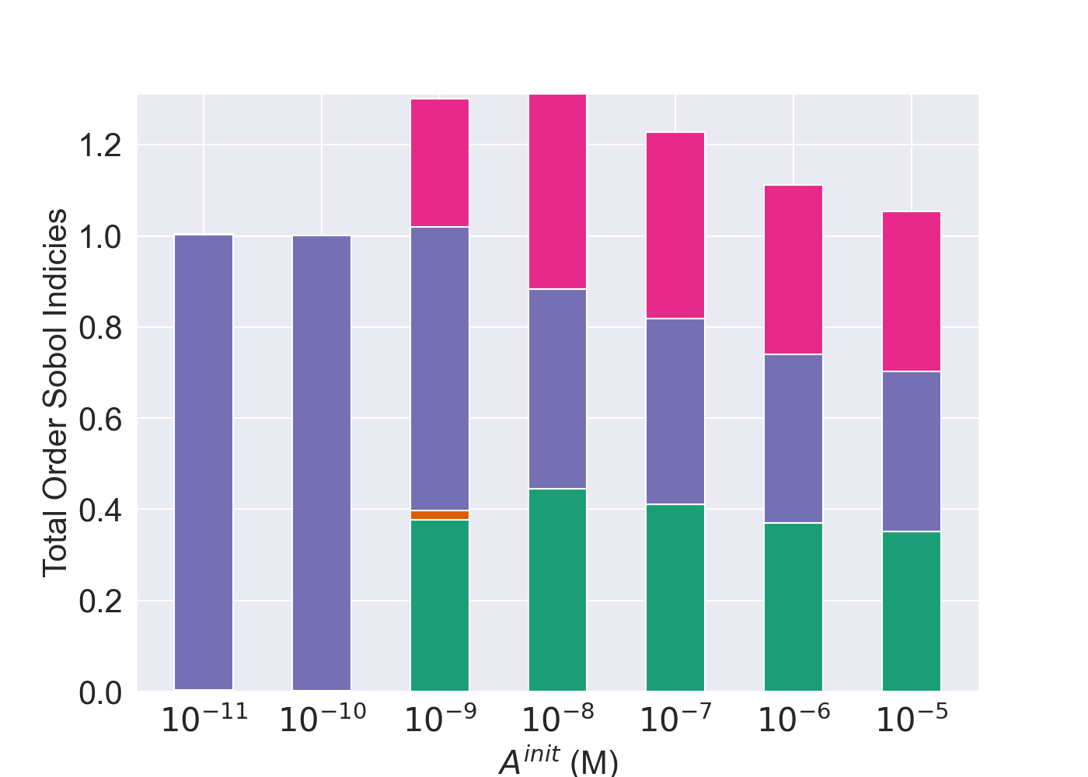
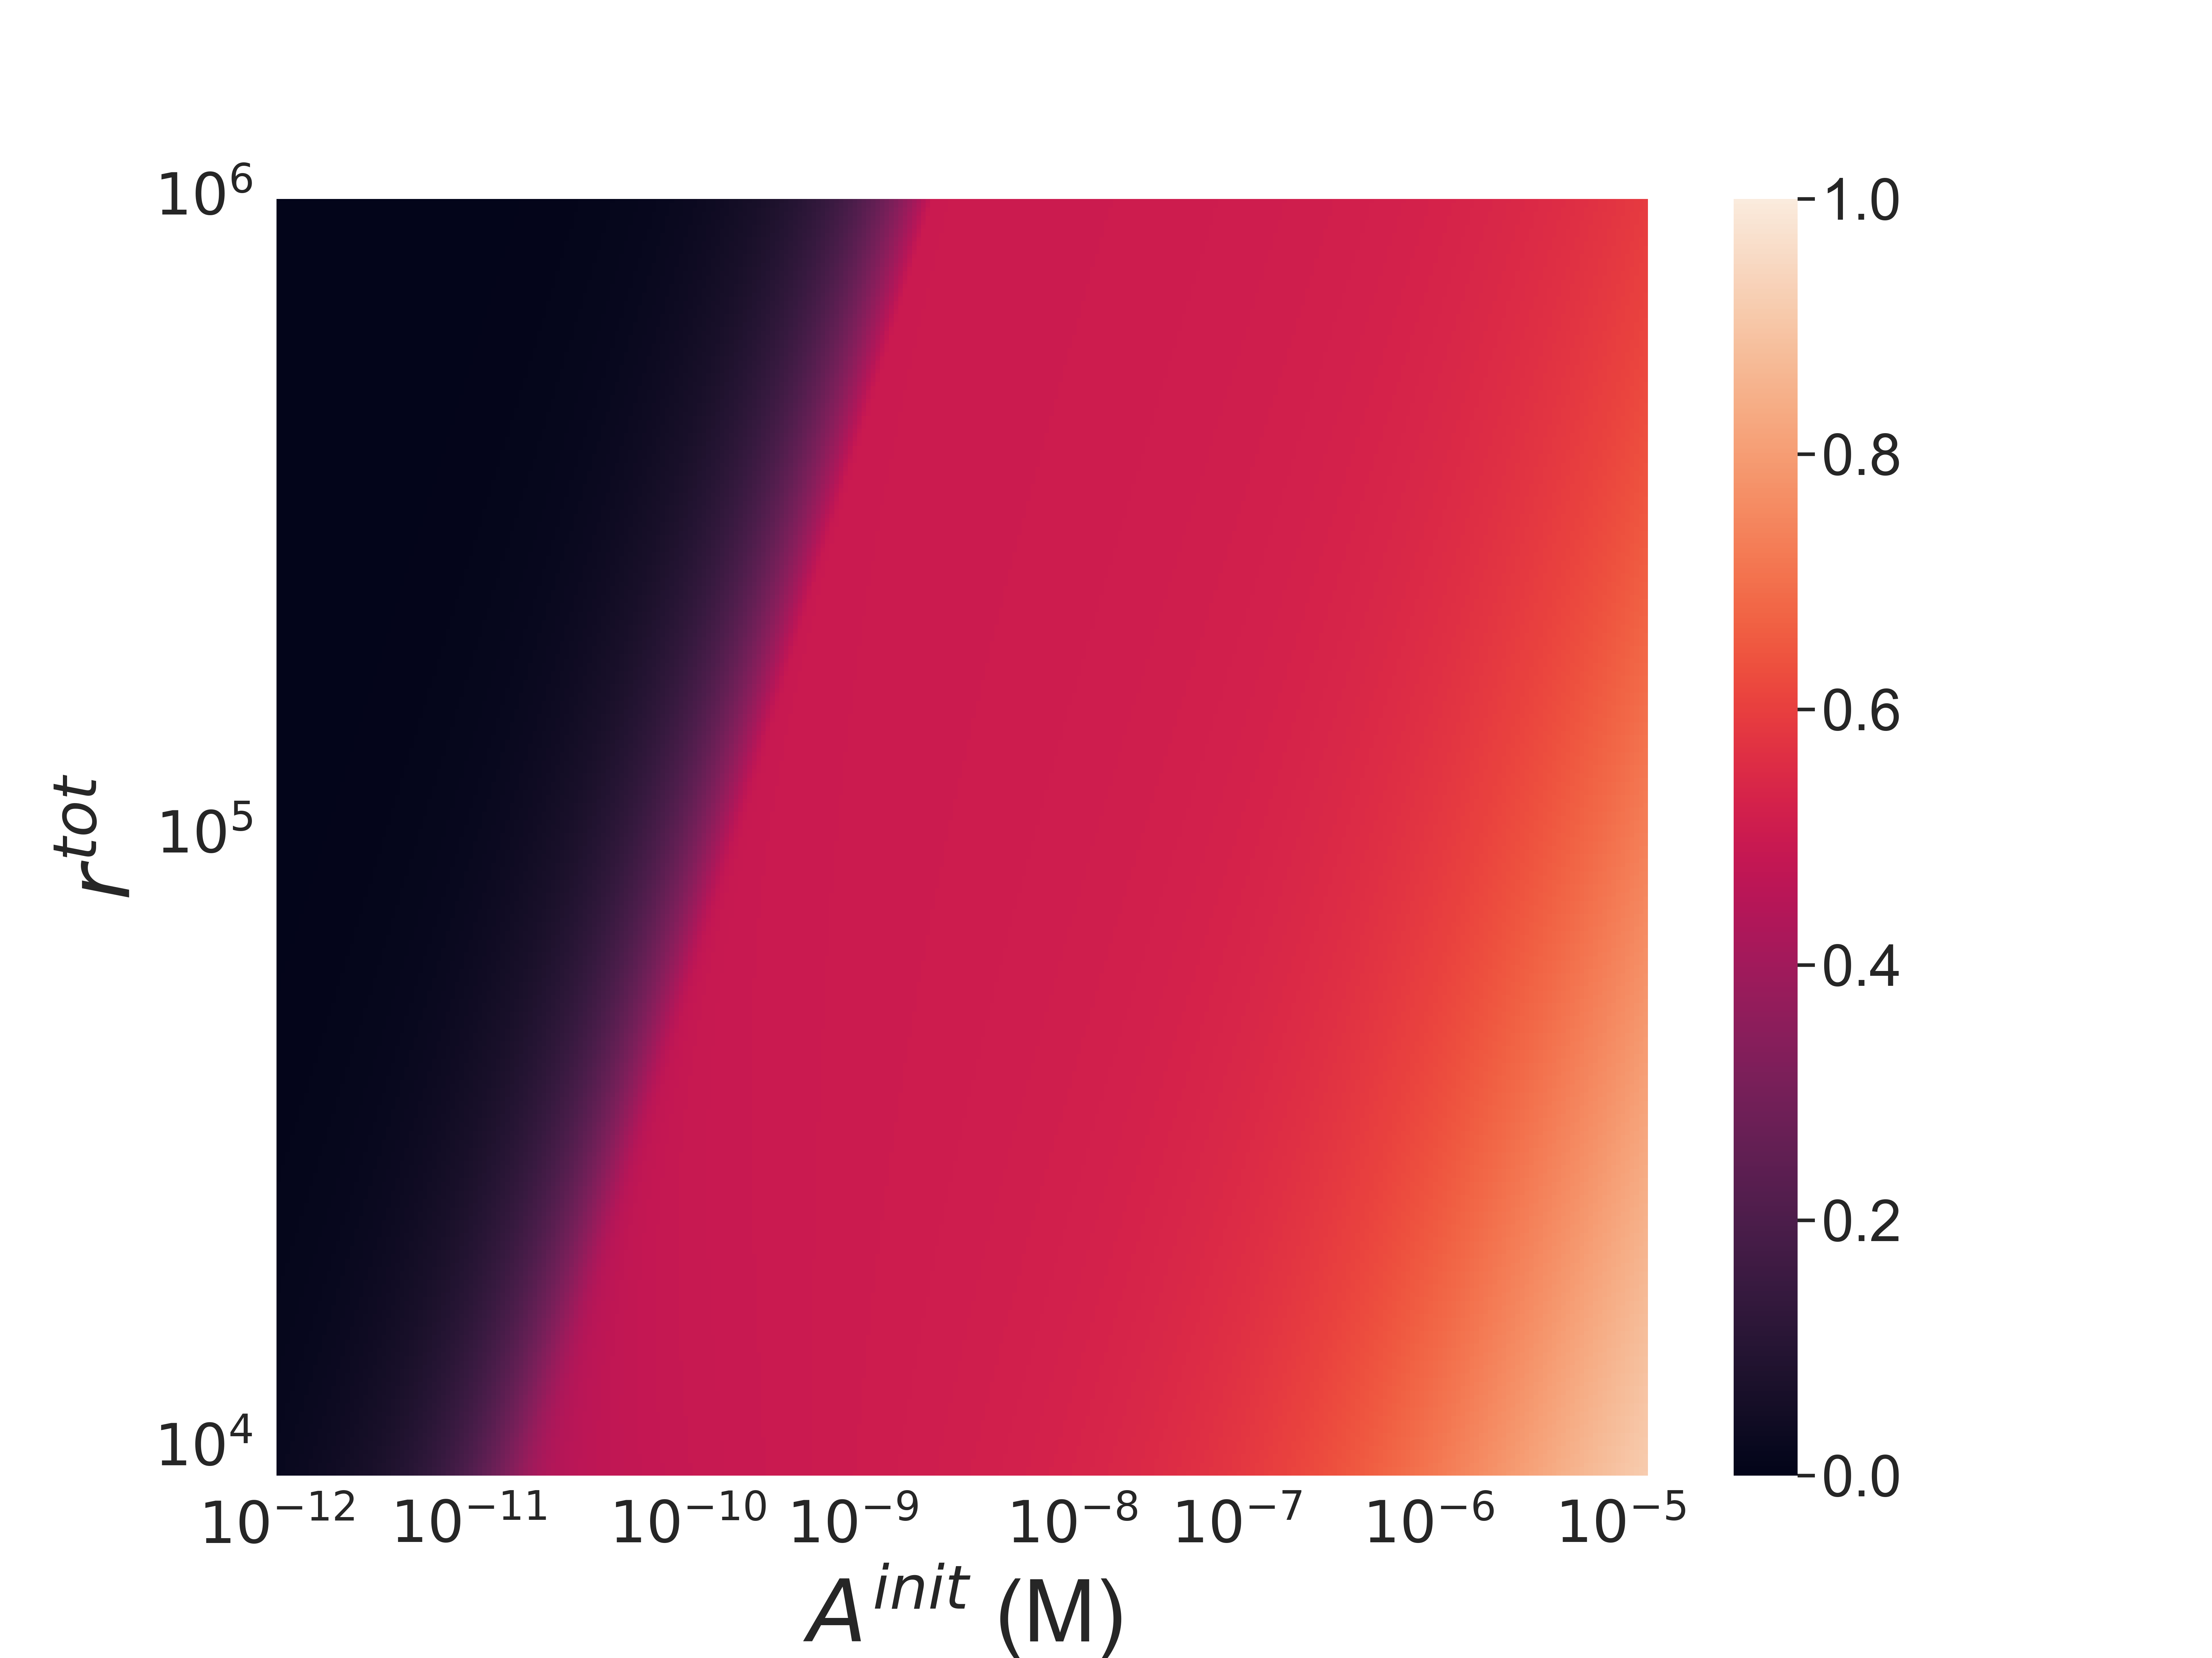
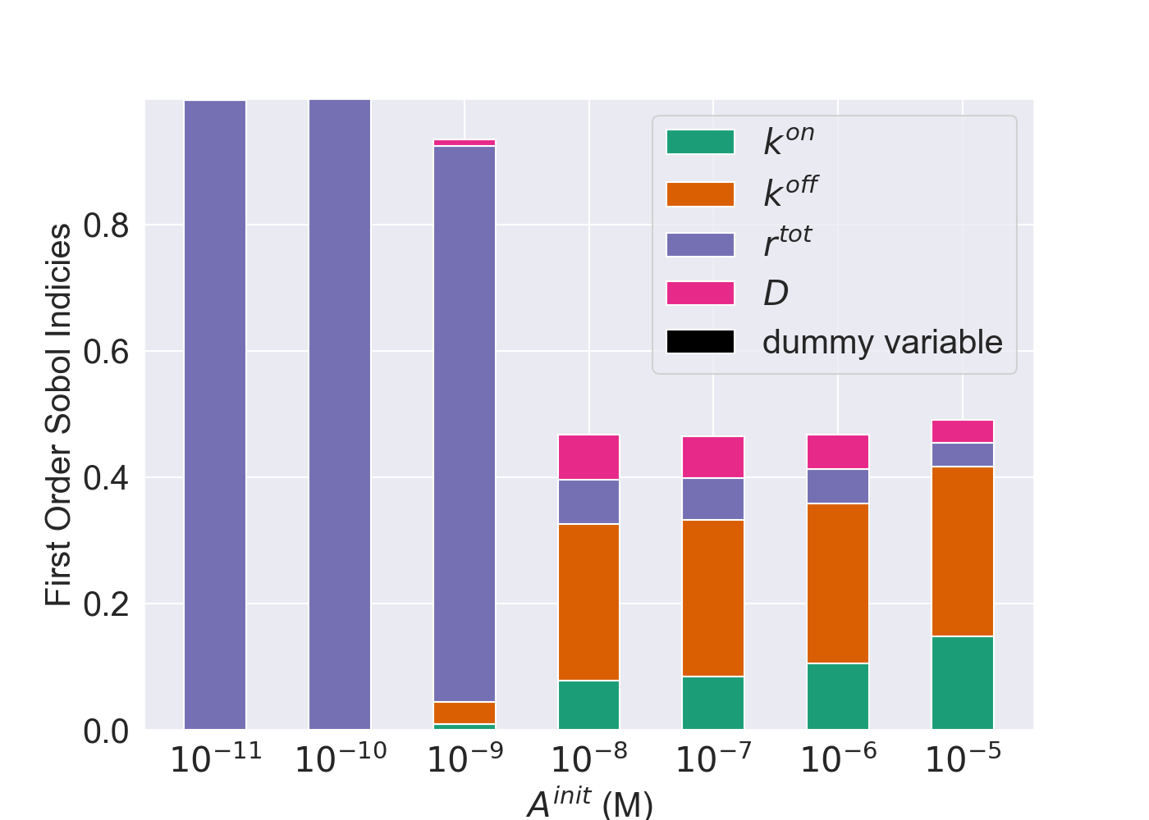
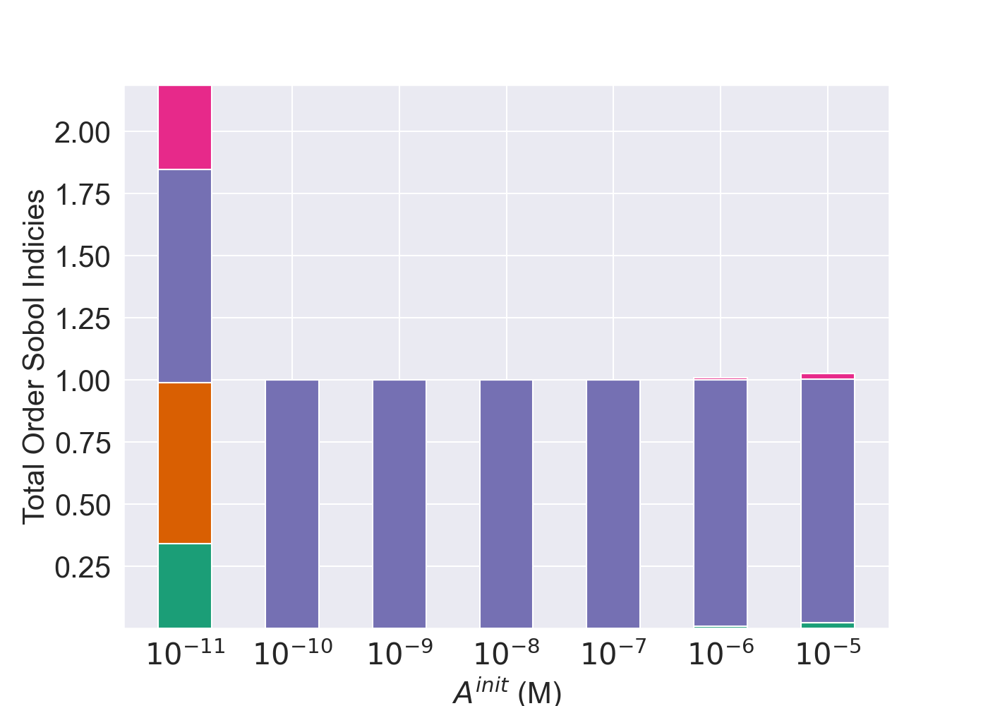
Maximizing the bound antibody number
Lots of receptors
High antibody concentration
Monovalent binding
Please!

Slide 8
Summary and Future WORK
Impact of antibody to receptor ratio on binding state
Global Parameter sensitivity analysis highlight ways to optimize effector function potency
Regions in parameter space where the avidity effect is large
Dynamics, bispecifics, multiscale model

